Slide 1
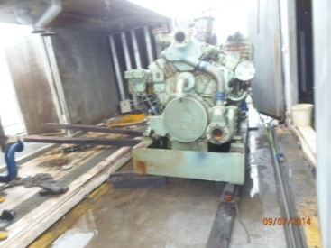
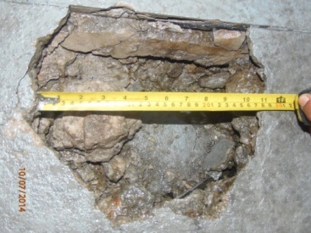
HS&E INCIDENT BULLETIN |  | 2nd half year 2014
Brazil | Type of incident - Dropped load
Summary:
The employee and co-worker were unloading an engine with a container using a set of equipment composed of pulleys, belts and a hydraulic jack. The 7.7 ton engine had been raised by the hydraulic jack and the employee was preparing a wood log base to place the engine on. While he was fitting the shim, the floor where the hydraulic jack was positioned suddenly gave way, causing a hole in the concrete floor approximately 10cm (4inches) in diameter by 15cm (6inches) in depth. The employee had three fingers trapped between the base of the engine and the wood log as the engine shifted due to the floor fixture.
Root Causes: | Actions Taken Thus Far: Next Steps
The amount of weight on the jack resulted in point loading on a small area of the floor, exceeding the floor’s capacity. | Repaired concrete floor, require use of steel sheet under the hydraulic jack to better distribute the weight.

